Slide 1
Automated Locker
Alden School District

Slide 2
Team Members
Mark Grassi
Sanjeevani Choudhery
John Fincken
Tristan Syre
Alex Kirschner
John McKissick
Sai Kham
Drew Clark

Slide 3
The Problem
Some students at Alden high school have difficulty opening lockers with a regular combination lock.
The locks are too small and complicated for some students to use.
The school wants an easier way for these students to open their lockers while still using a passcode.
Notes:
Alden High school special needs students
school wanted something that would students could use instead of a lockpad key and teach life skillz. so you have atm code, lunch codes etc.
from scratch except for the battery

Slide 4
Approach
Battery powered touch screen system to control solenoid lock
Screen’s embedded microprocessor will be used to check user input and signal solenoid
Custom 3-D printed case to mount screen in locker recess

Slide 5
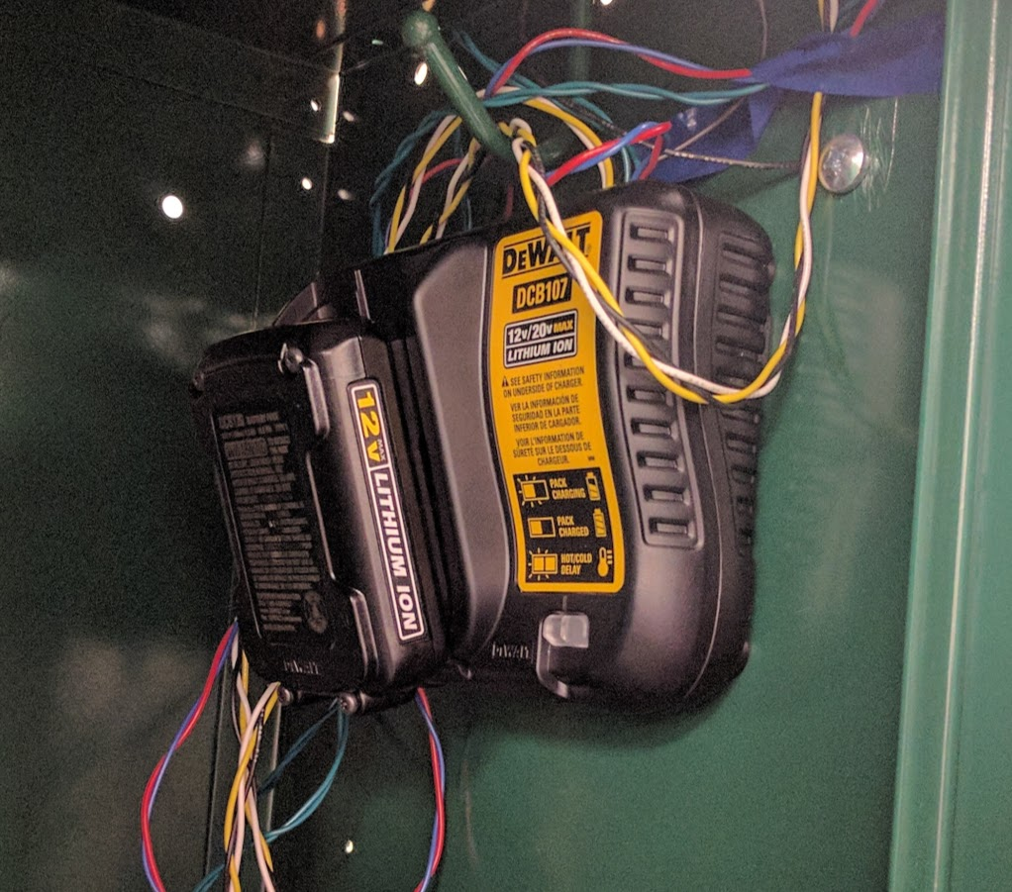
Circuit Housing
The Dewalt battery case has been gutted of all the circuitry. We mounted it at the top of the locker so it is out of the way and so it can avoid spills and water.

Slide 6
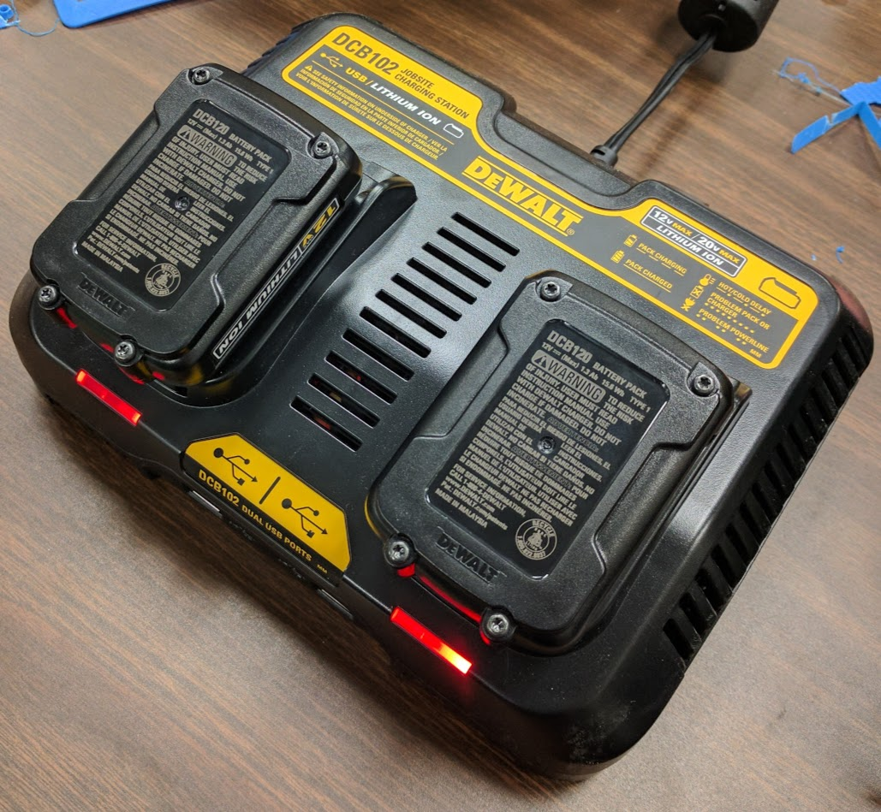
External Battery Charger
The external battery charger will be kept in the classroom to charge the extra battery when it is not in use.

Slide 7
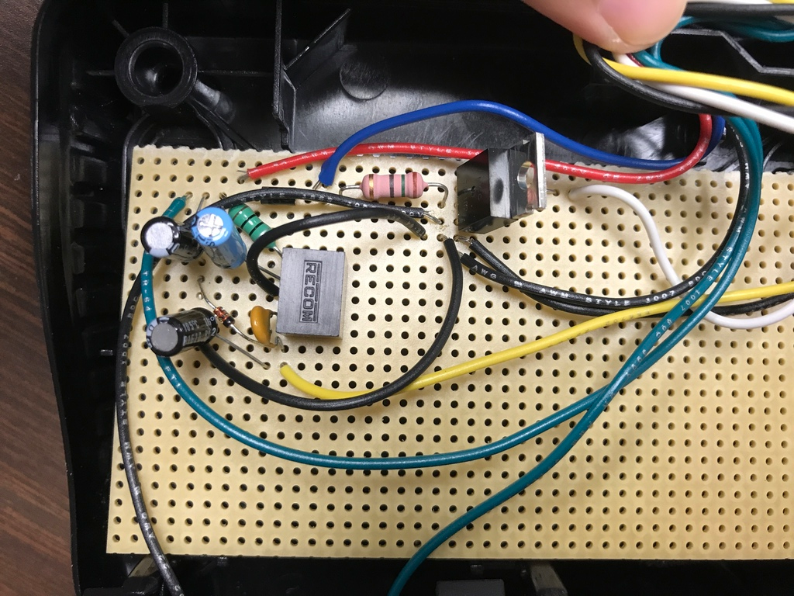
Inside Circuit Housing
The circuit was built on a perfboard which is mounted inside the Dewalt battery case.
The battery connected on the top will supply the power to the circuit which will then drive the screen and solenoid.

Slide 8
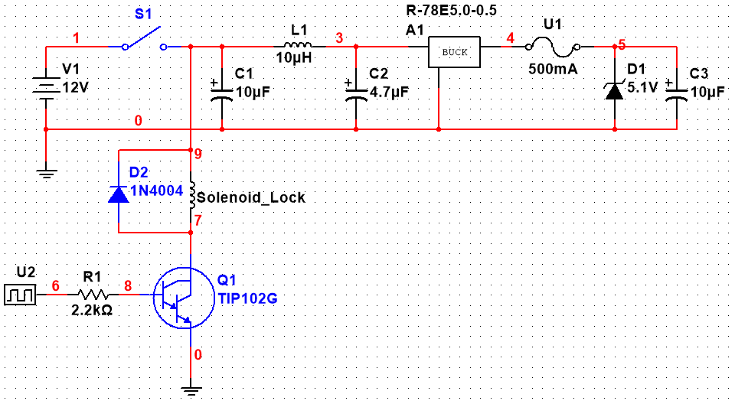
Circuit Design

Slide 9
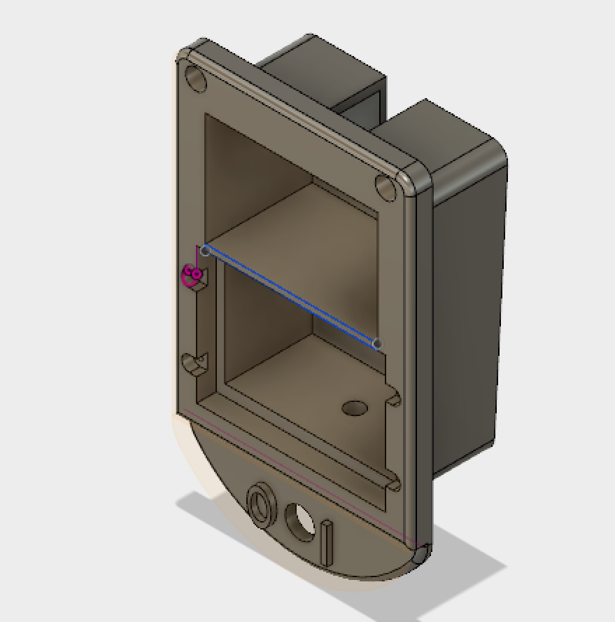
Screen Case

Slide 10
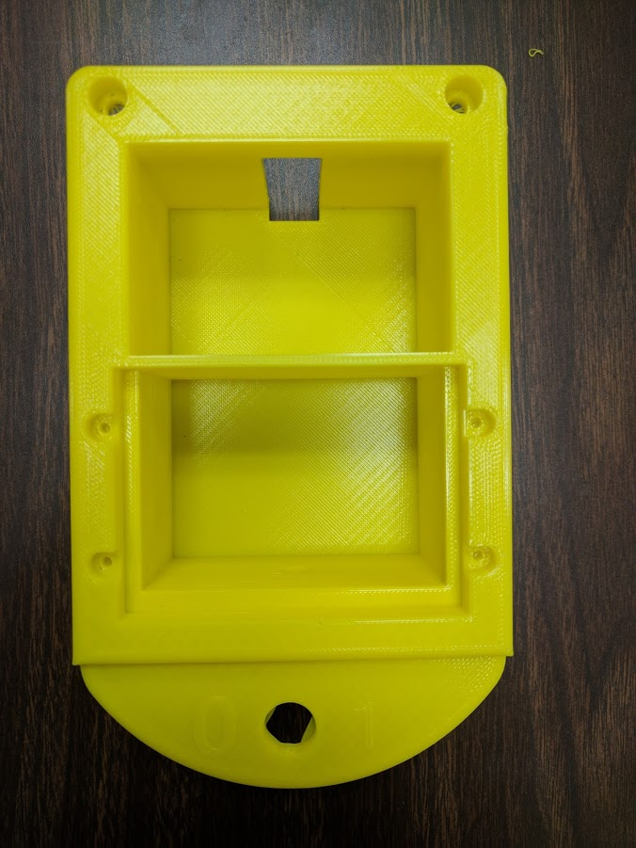
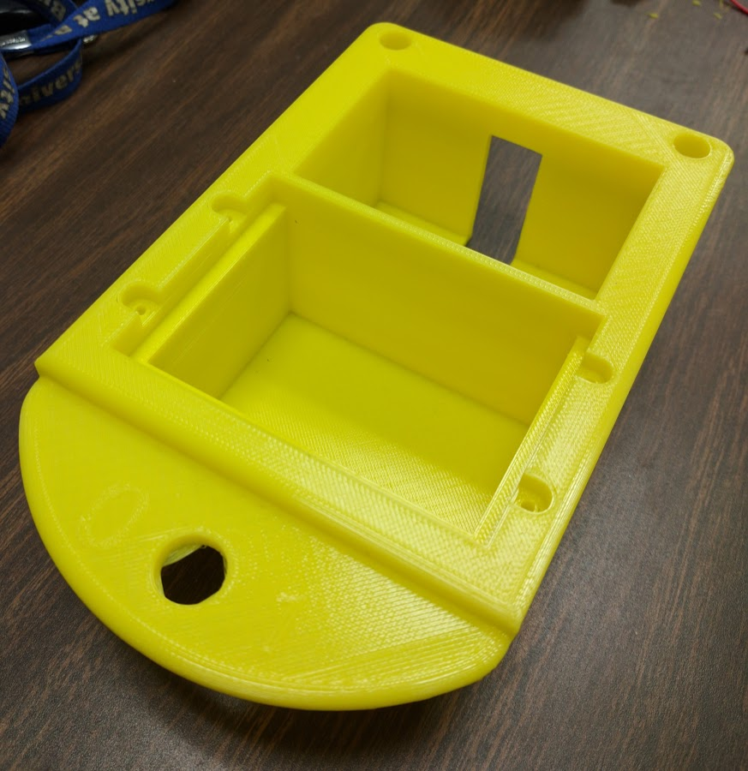
Screen Case

Slide 11
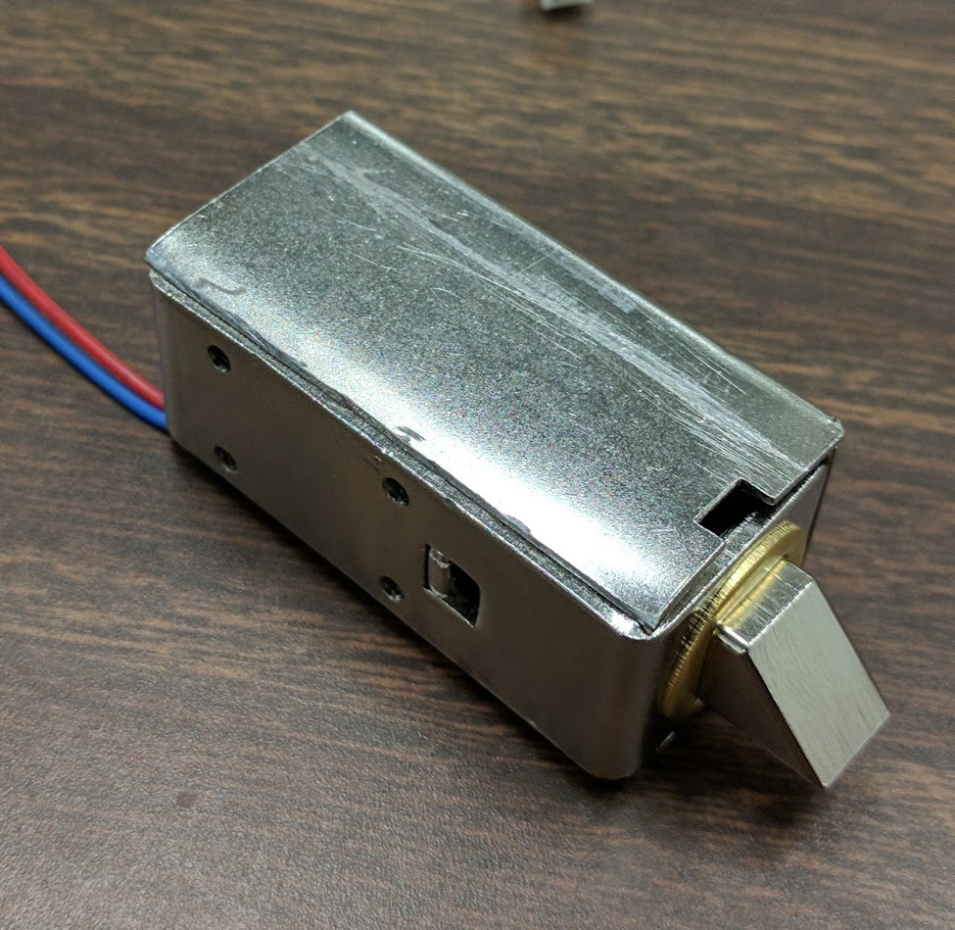
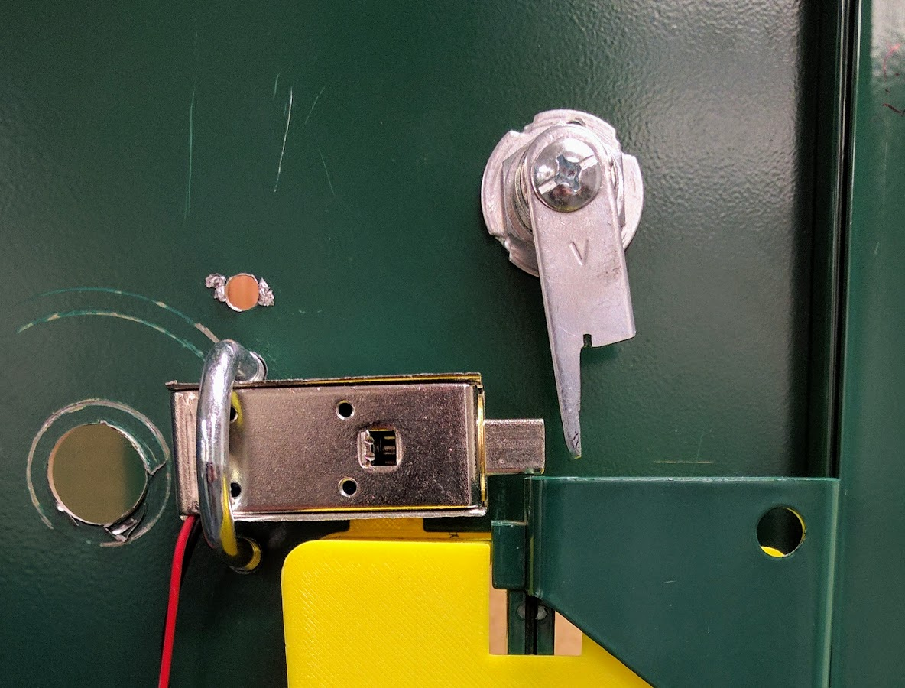
Solenoid
The solenoid remains in the locked position while no power is being supplied to it.
When the user enters the passcode the solenoid will open for 5 seconds allowing the user to lift the handle and open the locker.

Slide 12
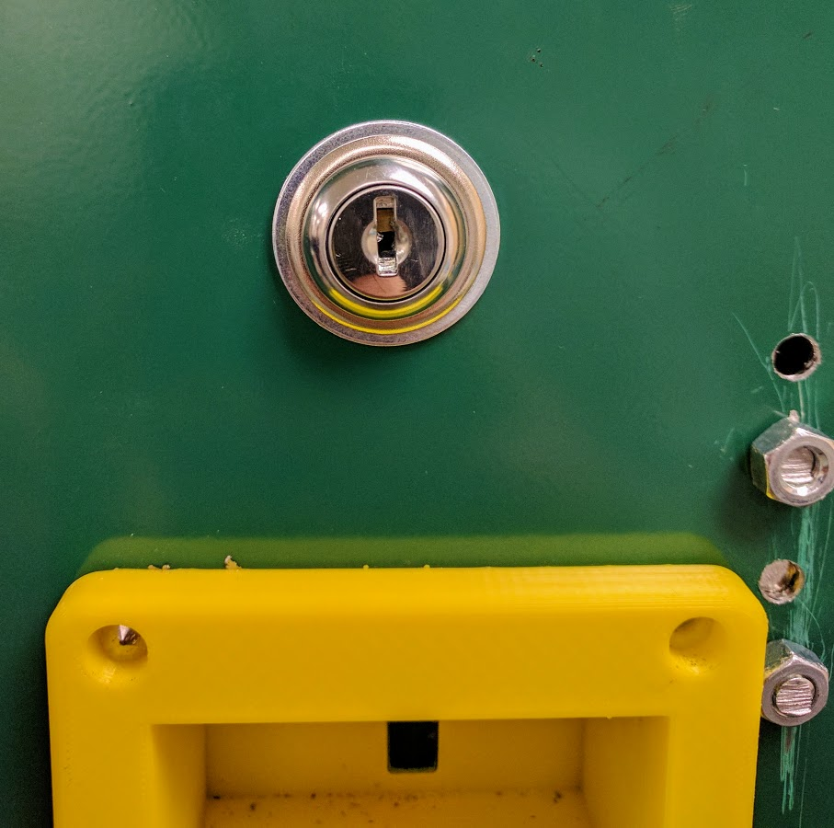
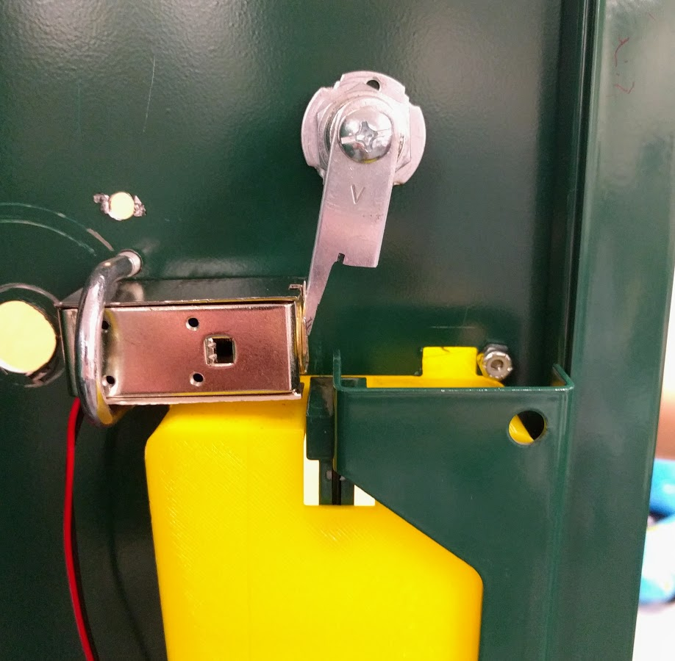
Manual Override
The manual override is used with a key we provide.
A plate will push the solenoid lock out of the way so the locker can be opened by faculty members or if the battery dies.

Slide 13
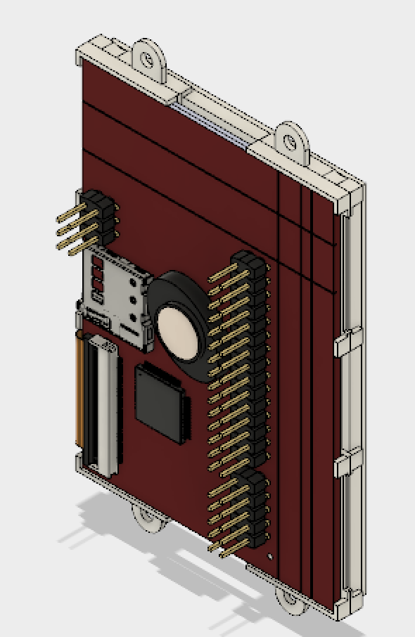
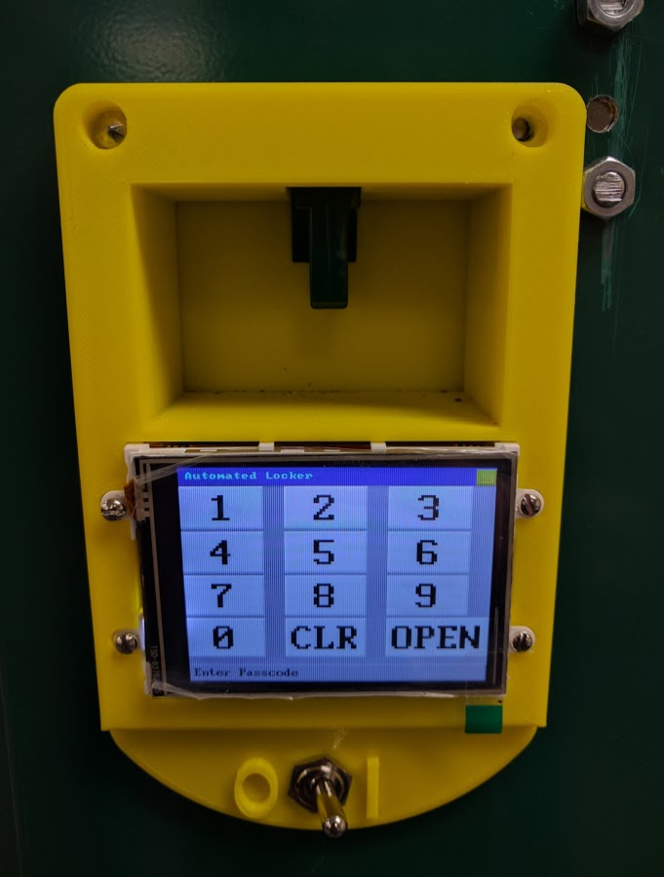
Screen
Student User can open
Admin User can reset password
Powers off when not in use

Slide 14
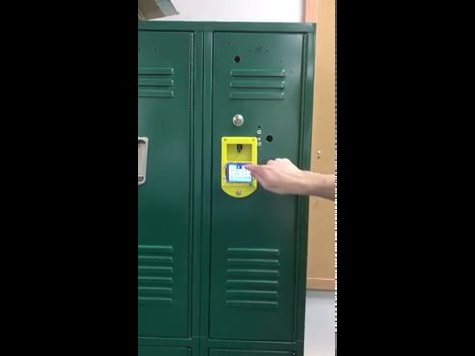
Locker Demo using the screen

Slide 15
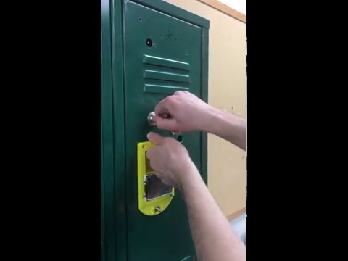
Locker Demo with manual override

